Slide 1
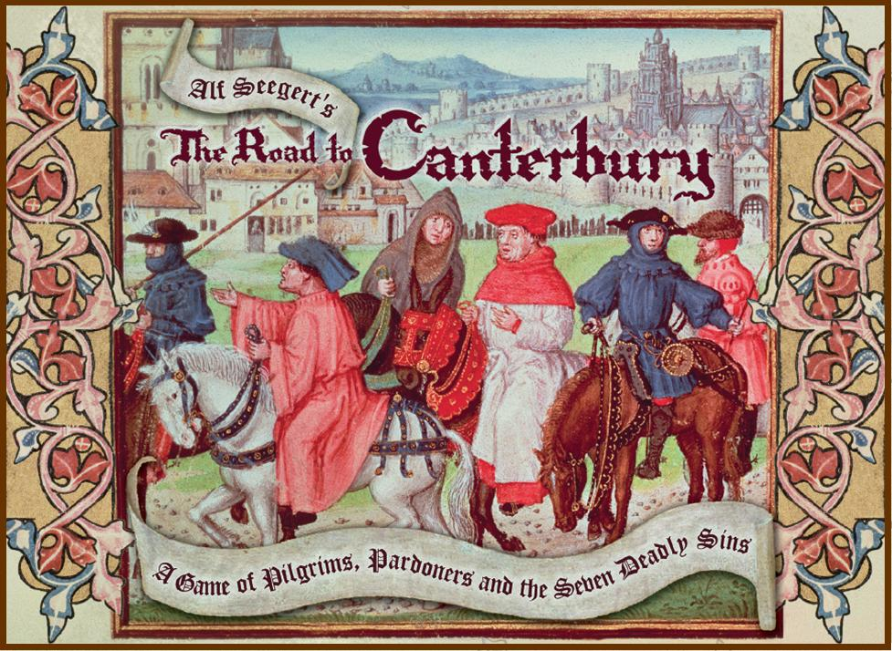
THE PLOWMAN’S TALE
By: Uzma Godherwala

Slide 2
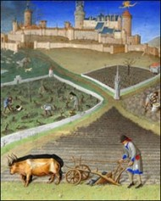
Job description
The Plowman has to do the dirtiest jobs of the medieval world.

Slide 3
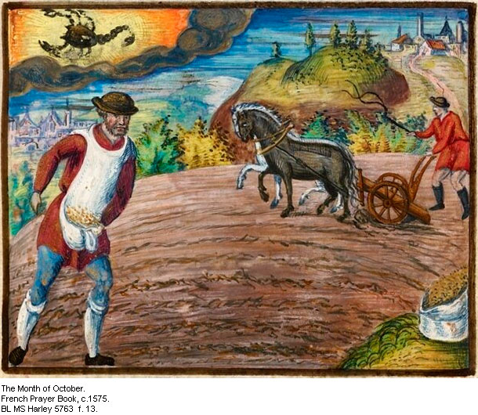
Plowman being ordered by his owner, really a hard work to do.

Slide 4
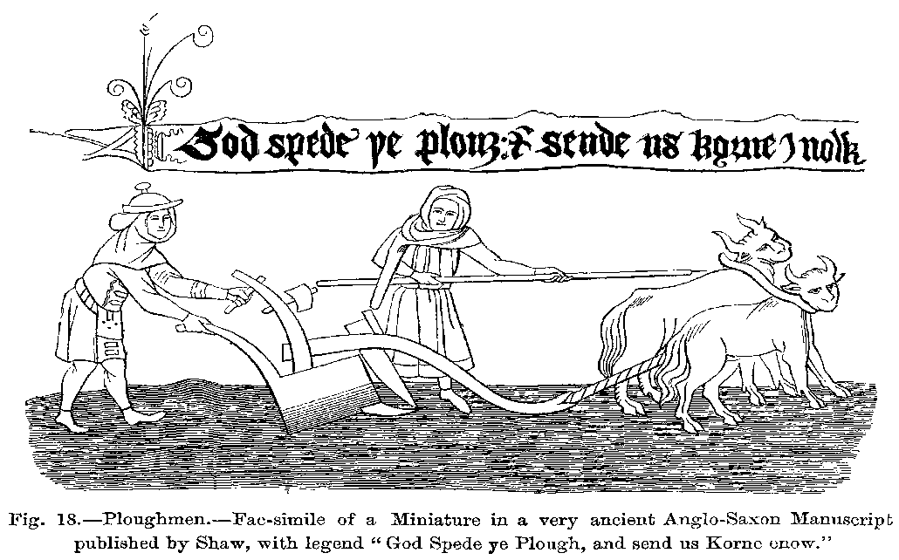
Character description
The plowman is just a holy man.
Living a simple life of hard labor.
The Plowman was the most recognizable medieval symbol of the poor and was associated with great virtue

Slide 5
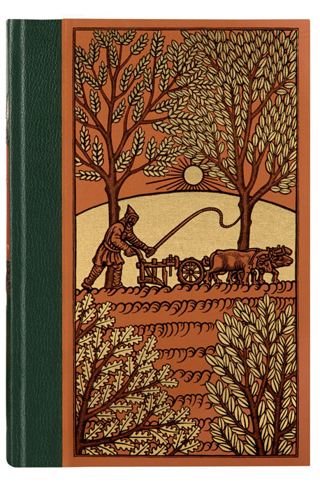
A fair field full of folk · found I in between, Of all manner of men · the rich and the poor, Working and wandering · as the world asketh. Some put them to plow · and played little enough, At setting and sowing · they sweated right hard And won that which wasters · by gluttony destroy.

Slide 6
Resource list
http://www.shmoop.com/canterbury-tales-prologue/the-plowman.html
http://www.enotes.com/homework-help/what-plowmans-tale-canterbury-tale-46755

