Slide 1
The Canterbury Tales
The Clerks Tale
British literature
Mrs.Alfred

Slide 2
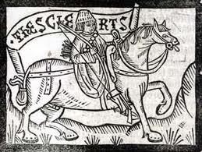
Clerks in the 1400s characteristic treats
c ncvchx
A clerk is a person who records all church business like marriages,births,and deaths the reason the were the only ones who did this were because they could read and write. Now a day’s isa call dependes your job description. Examples: legal banking, sales, or file.

Slide 3
The clerk in the tale character descripcion
He is a hard working philosopher, who dedicates his life to holly studies. He in his personal life has no friends because of his studies as well as in his books all day.And makes no money at all!!!

Slide 4
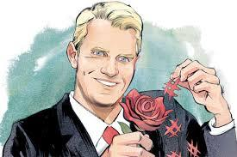
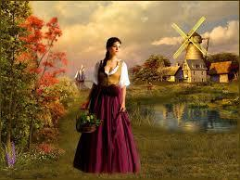
The Clerks Tale
A peasant, named Griselda
A marquis called Walter

Slide 5
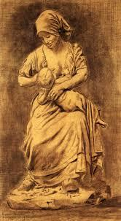
griselda baby girl

Slide 6
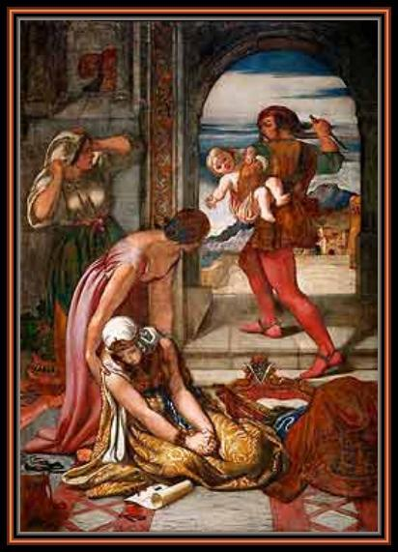
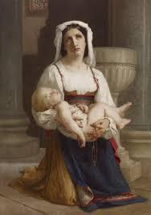
griselda's daughter gone
so called dead but hide away for trust

Slide 7
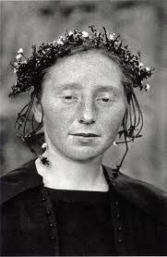
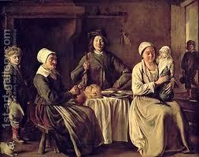
griselda's so called dead daughter
They lived happily ever after

Slide 8
The moral of this tale is ….
I think that the moral of this tale is that no matter what happens loyalty is the key to final confert

Slide 9
Resources
http://en.wikipedia.org/wiki/The_Clerk's_Tale
http://www.cliffsnotes.com/literature/c/the-canterbury-tales/summary-and-analysis/the-clerks-prologue-and-tale

