Slide 1
The magistrate’s tale
By: Natalie Ortiz

Slide 2
Characters
Phoebus
White Crow
Phoebus’s Wife

Slide 3
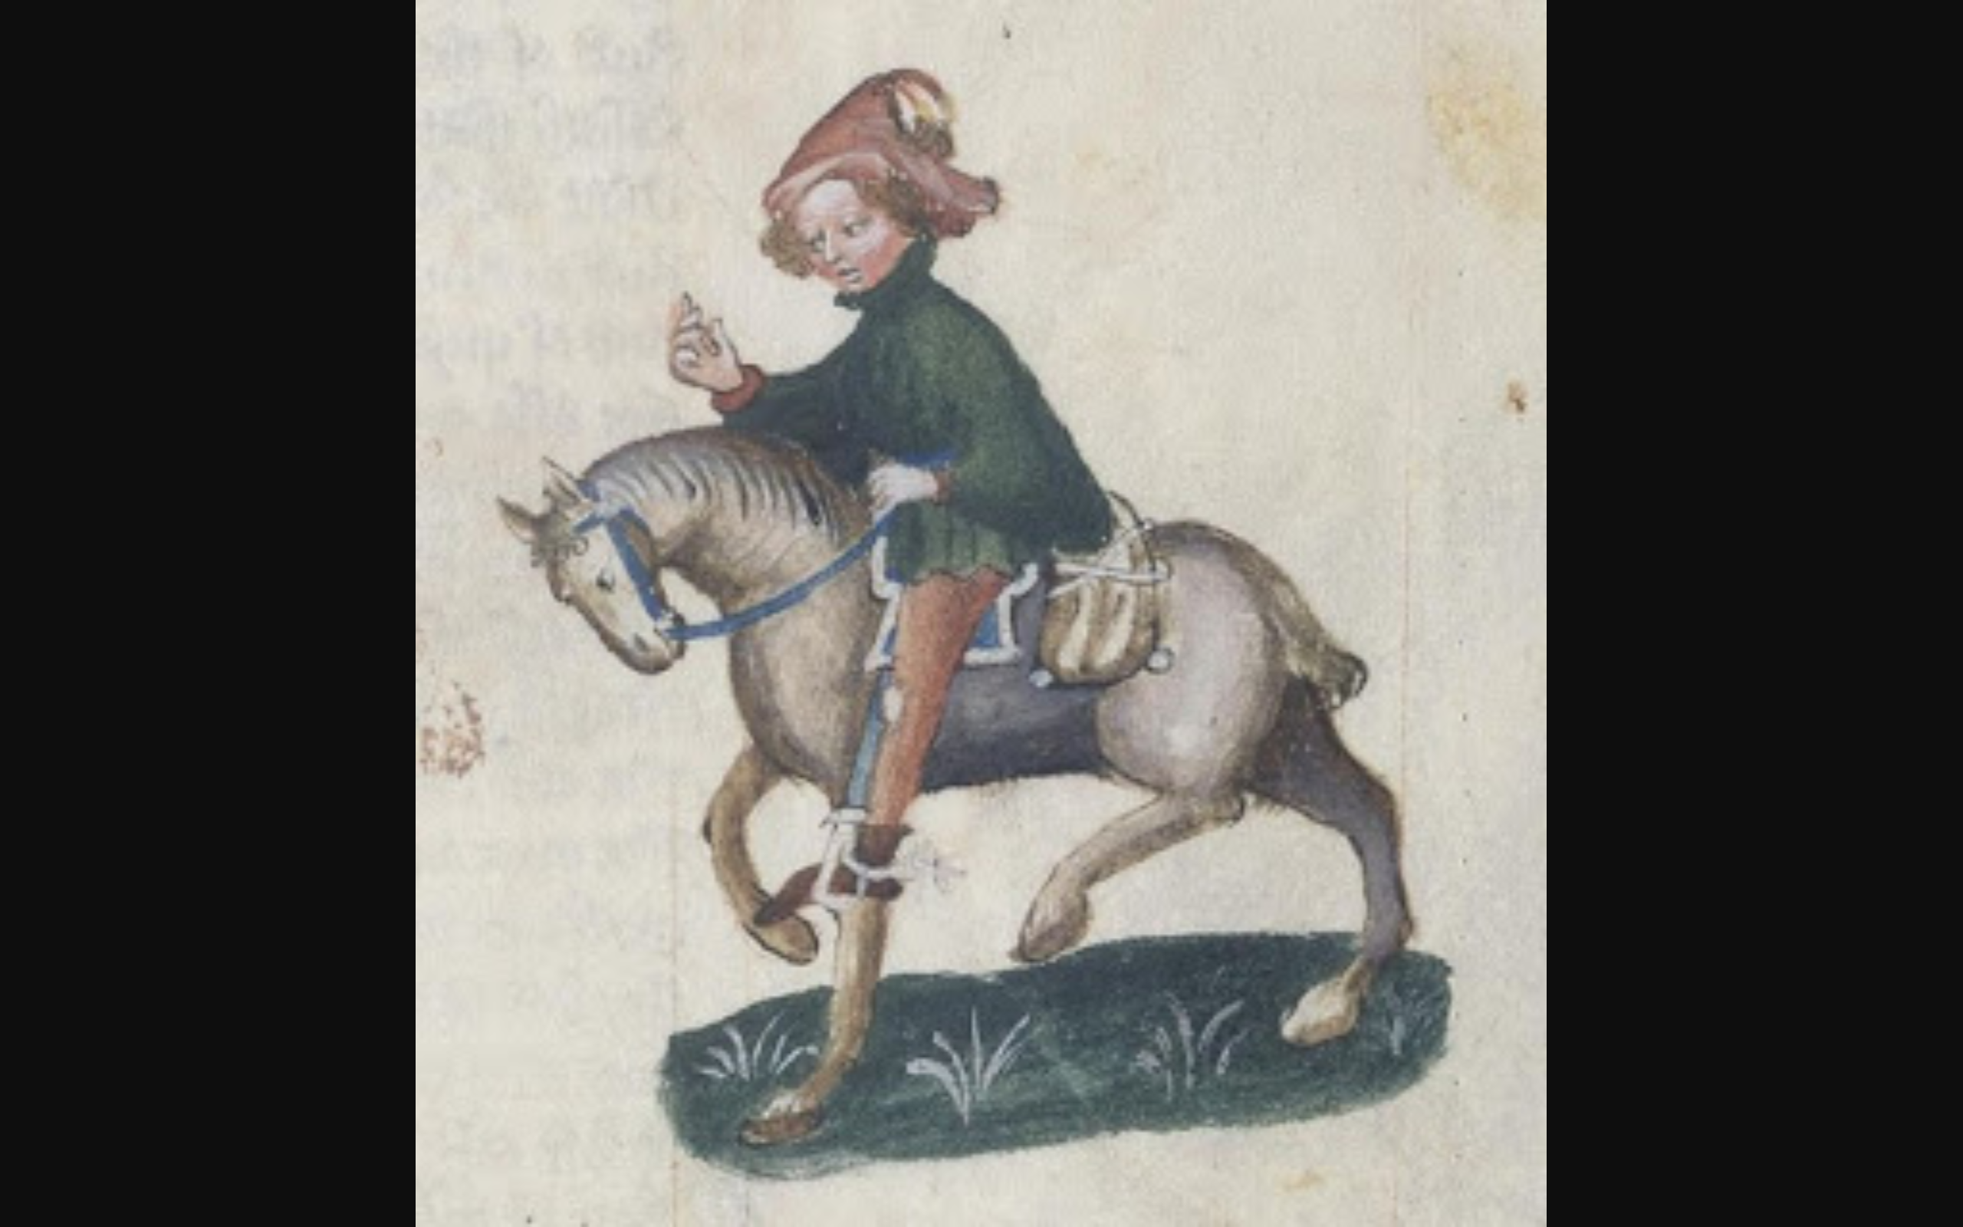
The Magistrate’s Tale

Slide 4
Story Summary
Phoebus, god of poetry, he was the lustiest of bachelors. He kept in his house a white crow, which could imitate the speech of any man. Phoebus also had a wife, whom he loved more that his own life, and did his best to please her and treat her courteously, he was extremely jealous, and so would watch her suspiciously. So he tells her to take a bird home and keep it in a cage. His wife had another man, “of liter reputation”, hardly worth comparing with Phoebus himself.

Slide 5
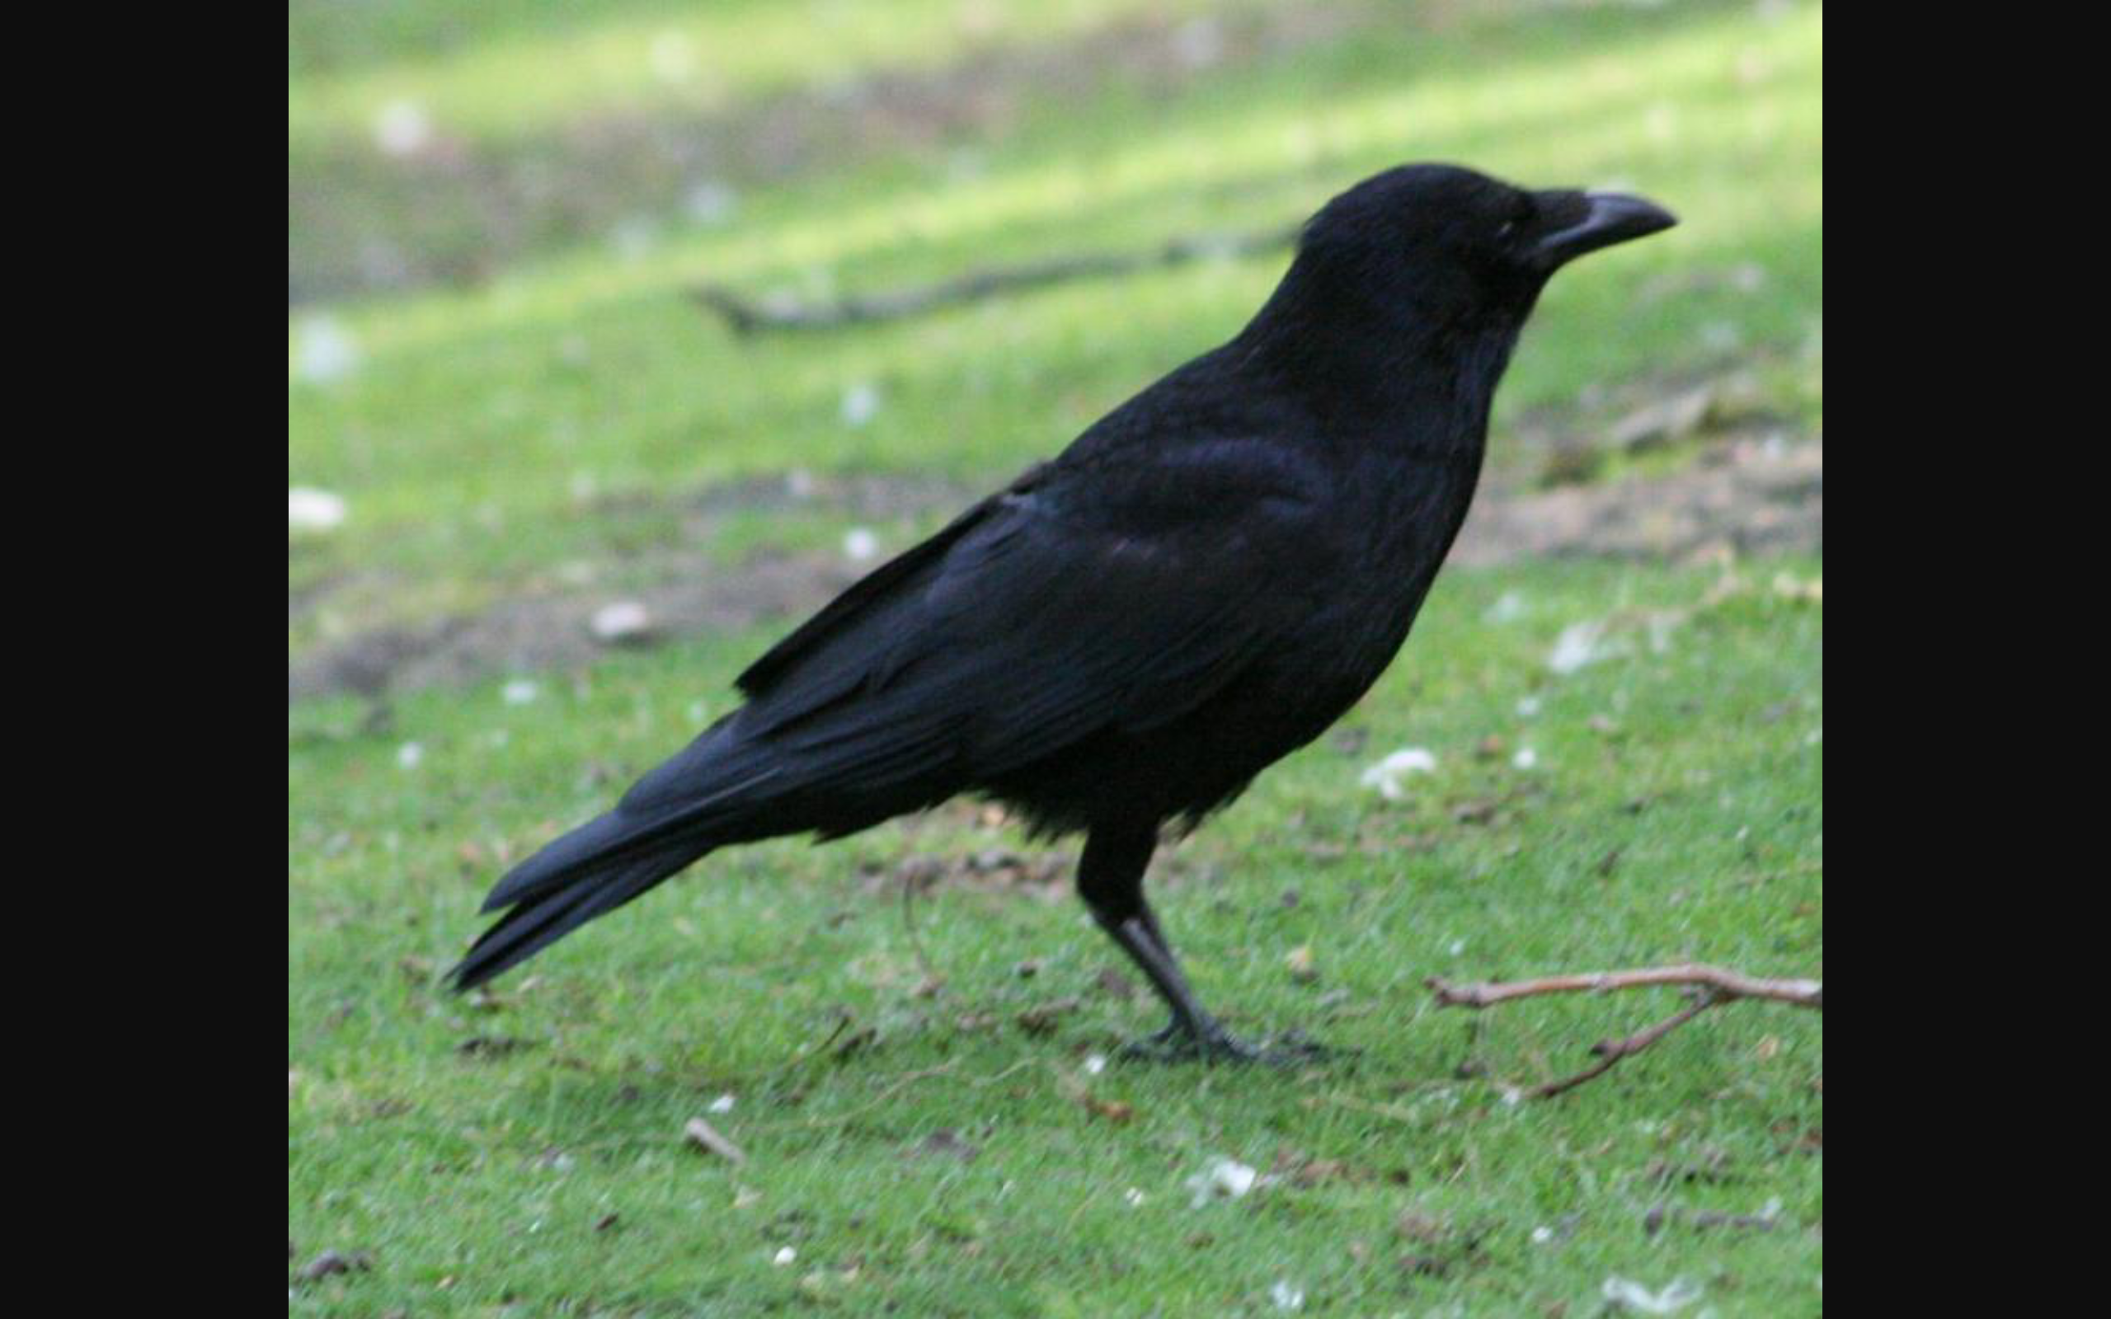
One day when Phoebus was away, she sent for her “lemman”. The white crow saw their “ working” together, and said nothing until Phoebus returned home, when the crow sang “cokkow! ckkow!” Phoebus Initially thought the bird sang a song he did not recognize, but the crow clarified that his wife had had sex with a man of little reputation on his bed. His heart Burt in two, he took his bow and killed his wife and accused the crow of lying to him, so he pulled out all the white feathers of the crow, made him black and took away his song and speech. It is for this reason that all crows are black.
The End

