Slide 1
FADI ILIAS
Rm:402
Period:6

Slide 2
HI EVERY ONE
MY PRESENTATION ABOUT
THE
BLACK DEATH

Slide 3
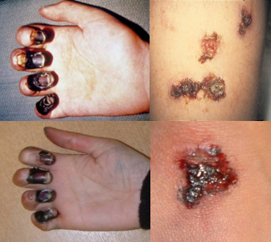
What type of illness it is?
The black death was made by rats.

Slide 4
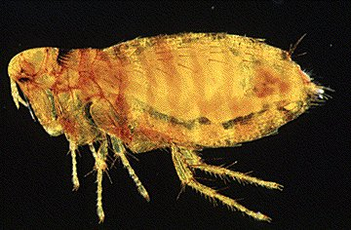
What is vector born?
Vector-borne disease is the term commonly used to describe an illness caused by an infectious microbe that is transmitted to people by blood-sucking arthropods.

Slide 5
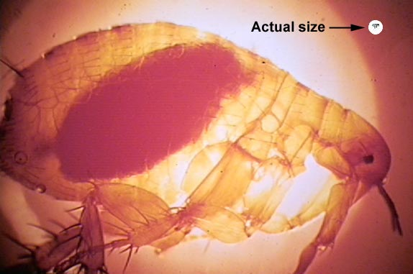
What is the vector animal?
Vector borne infections,diseases caused by pathogens transmitted by insects and ticks, have long impacted human affairs.

Slide 6
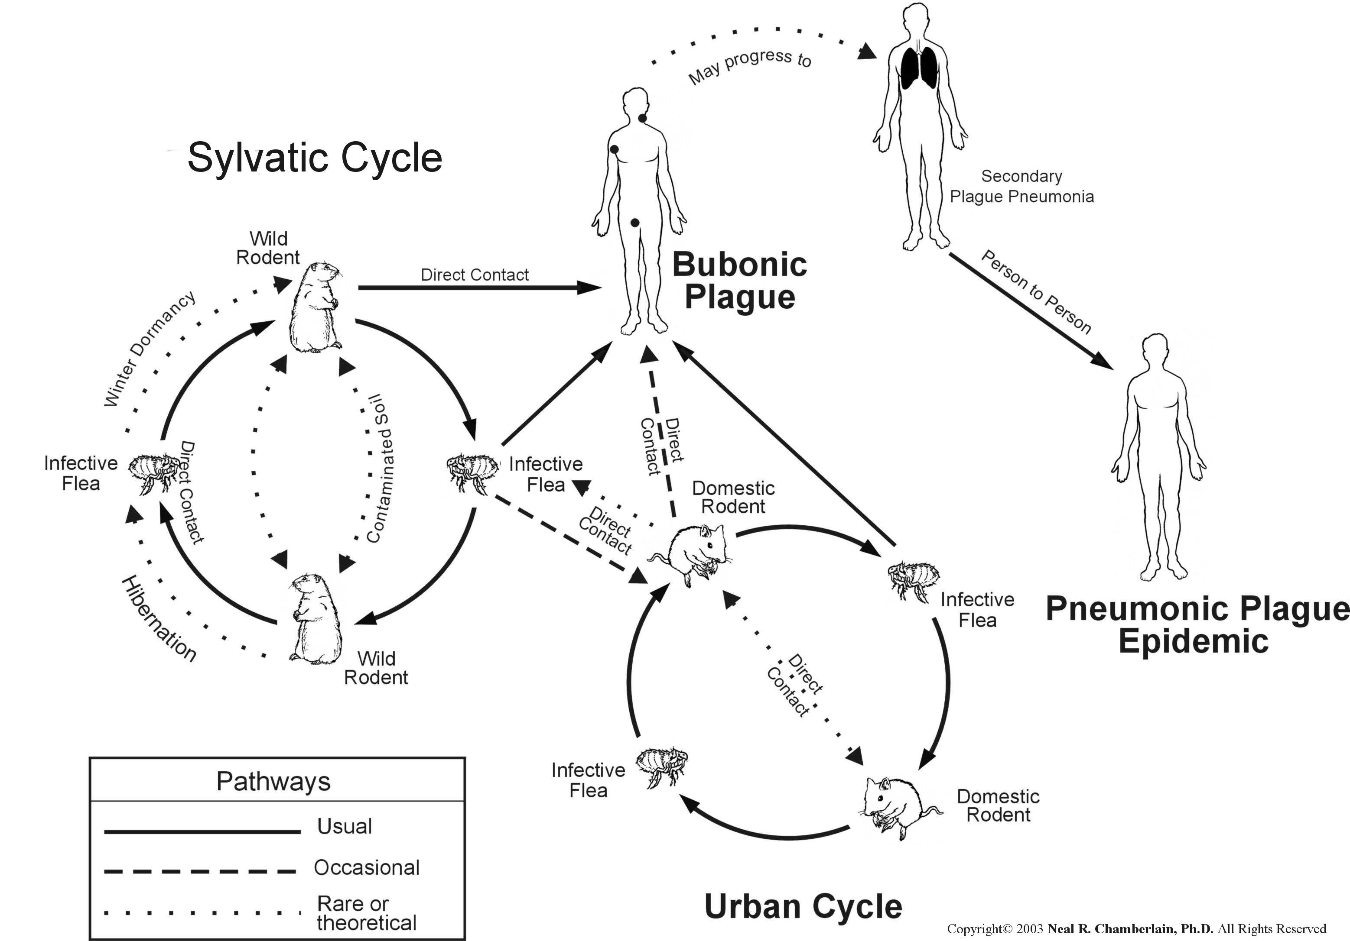
What is vector born?
The Black Death was a disease of rats and other rodents.

Slide 7
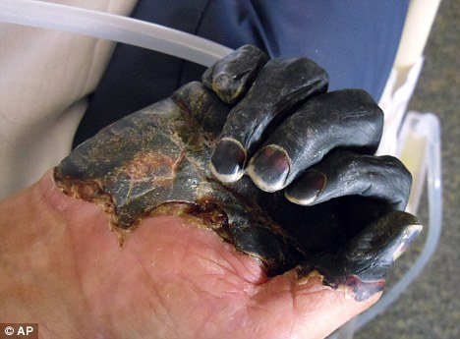
What are the symptoms of the disease?
The Black Death came in three forms, the bubonic, pneumonic, and septicemic. Each different form of plague killed people in a vicious way.

Slide 8
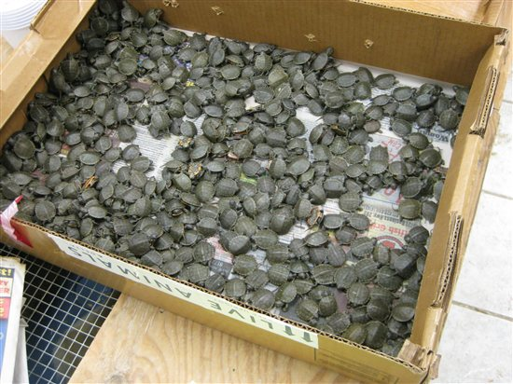
IF the Black Death survive, what are some of the health issues you may have?
We do not have accurate records of the percentage of people who survived the Black Death after getting it.

Slide 9
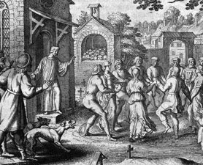
Does it affect children or adults or both?
Children were abandoned when their parents died of the disease and left to die themselves, since few good but frightened citizens would take them in.

Slide 10
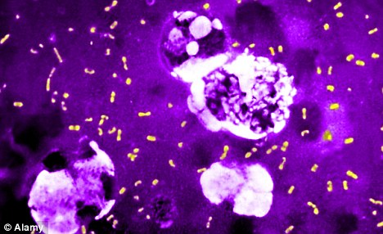
how does the black death spread?
In towns and cities people lived very close to each other.
The filth that littered the streets gave rats the perfect environment to breed and increase their number.

Slide 11
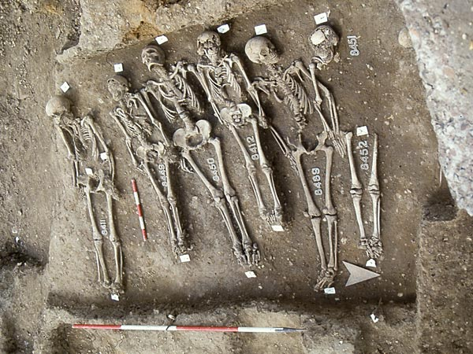
When was it developed?
The Black Death was a catastrophic event in Europe's history. It had both devastating immediate effects and deep long-term consequences.

Slide 12
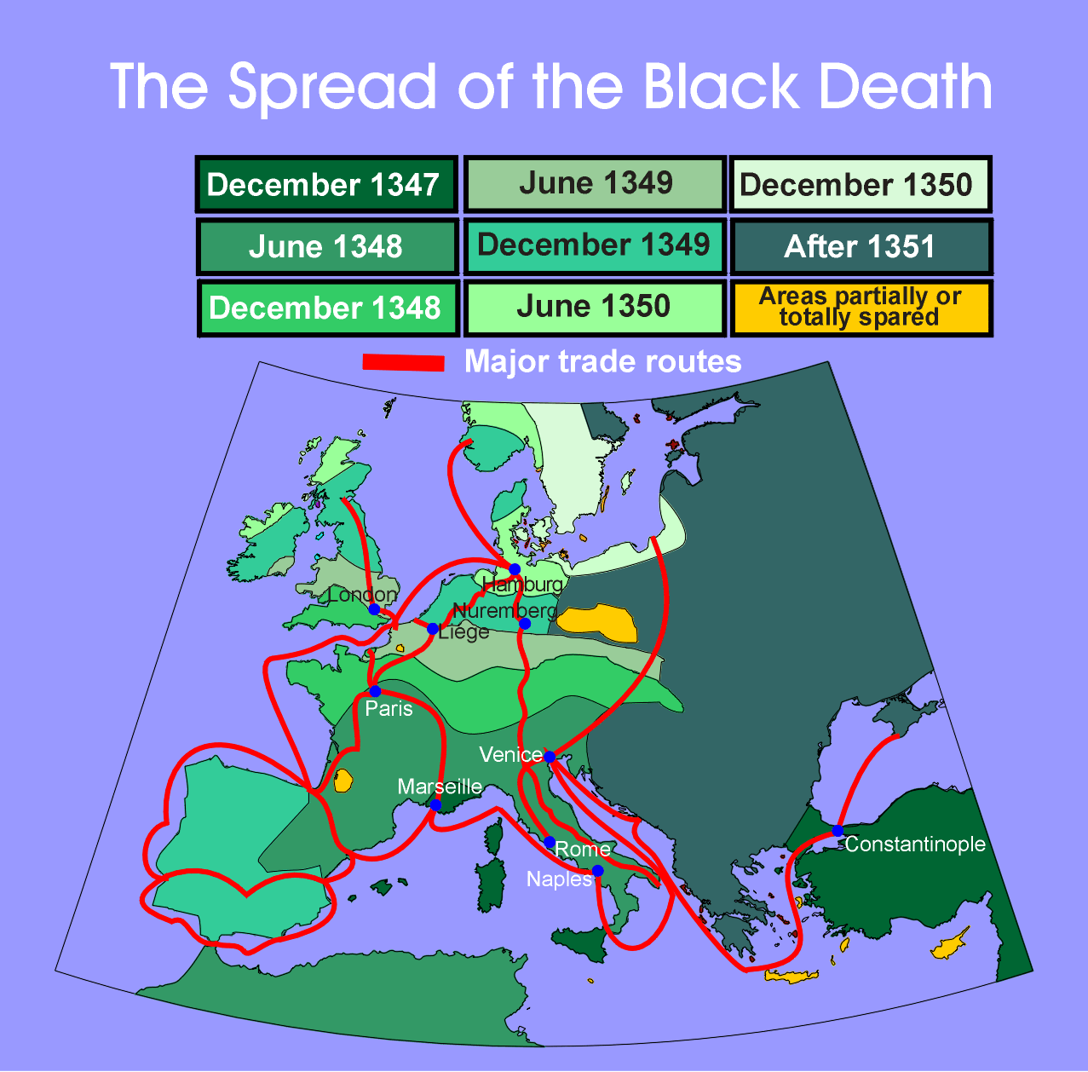
where did the black death found?
In the 14th century a horrible disease struck Asia, Africa, and Europe. The people called this illness the Black Death. The disease started in Asia in the 1340's. It quickly spread to Africa, and throughout Europe.

Slide 13
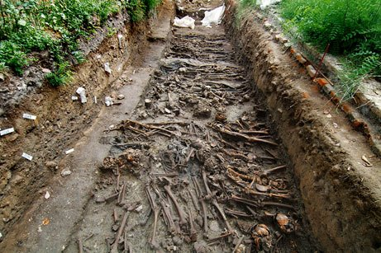
how many people died from the black death?
There were 75 million people that were killed by the Black Death

Slide 14
The END OF THE BLACK DEATH

