Slide 1
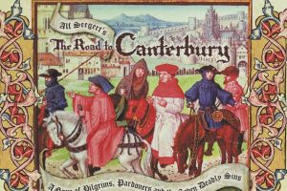
-- By Geoffrey Chaucer
Introduction to the Canterbury tales:
Once upon a time, there were near about 29 pilgrims who were going to their pilgrimage. On their way going to pilgrimage, they had a stop at the Tavern. There the Host Geoffrey Chaucer decides to join them. For the purpose of their entertainment the Host had an idea that everyone in group has to tell a tale while going on their way and everyone agrees to his idea.
Everyone tells a tale when its their turn. Now it was the Squire’s turn to tell a tale.

Slide 2
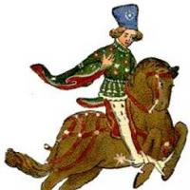
The Squire
The Squire was 20 years old son of knight
He was a young, handsome, and curly haired guy
He loved to dance and had great passion for music

Slide 3
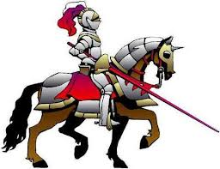
Introduction:
As Love was Squire’s favourite subject, he was asked to tell a tale on that subject.
His main characters were:- the Knight, King Cambuscan and his beautiful daughter Canace.

Slide 4
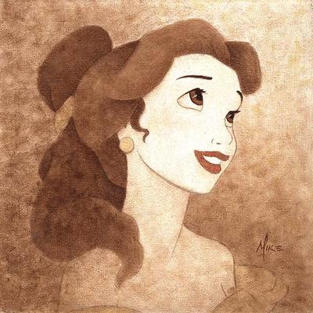
The tale begins...
Long ago there lived a king named Cambuscan. He had a wife Elpheta, two sons- Algarsyf and Cambalo and a beautiful young daughter Canace.

Slide 5
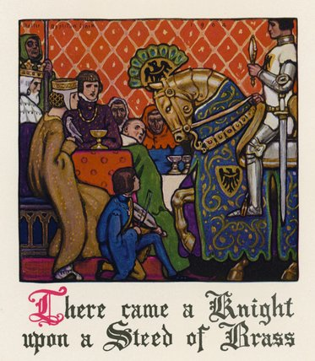
Ides of March....
On Ides of March (march 15th) it was king Cambuscan’s birthday. In this honor, he declared a feast all over his land. During the feast there came in a knight riding on a brass horse, holding a mirror and wearing a ring in his thumb and on his side a sword was hanging

Slide 6
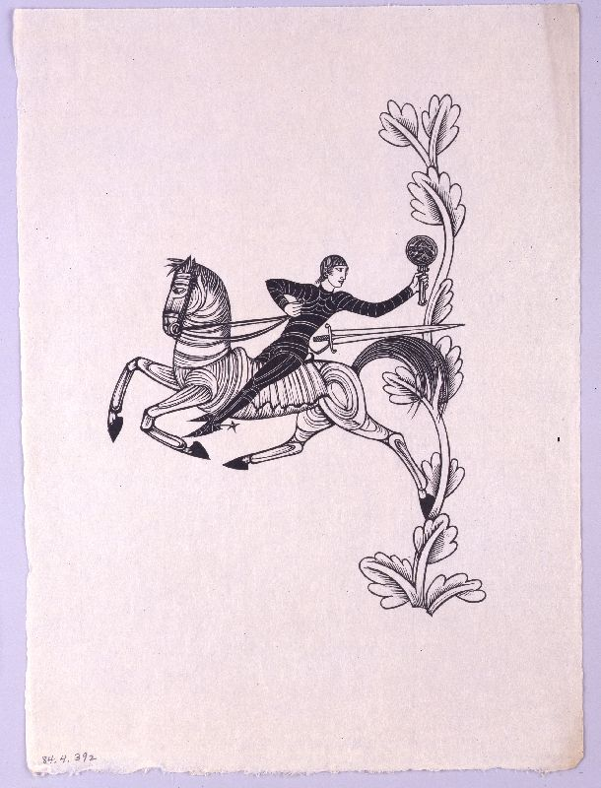
Knight ...
He was sent by the kings of Arabia and India
He greeted everyone in the hall
Then he presented the gifts sent by Indian and Arabian kings
The gifts were: - a brass horse, a magical mirror, a magical ring and a magical sword.

Slide 7
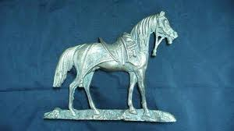
The Brass Horse...
The brass horse had the magical powers such that when a knob near its ear is turned, and then said the name of the place desired by the king, it will take him there.
It can also bring him back with in a day
If the king wants to rest on the horse’s back he can

Slide 8
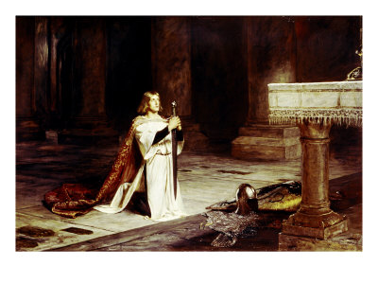
The sword...
The sword had the power that it could cut any man though he is wearing an armour as thick as an oak.
The wound created by this sword can not be healed by anything
But if the king desires to heal the wound of that man he just has to pass the sword through that wound.

Slide 9
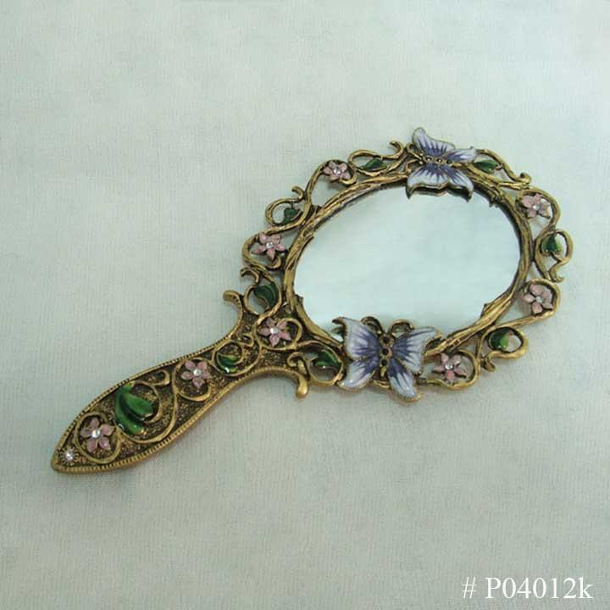
The Mirror...
The mirror had the power to show the faithfulness of man.
It was specially designed for women
A woman can see whether the man was faithful with her or not.

Slide 10
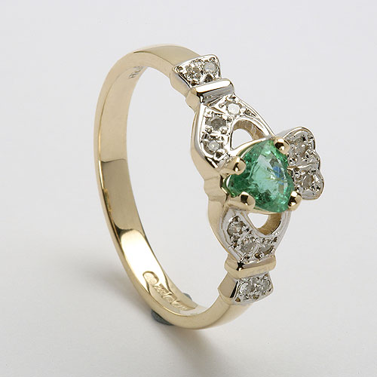
The Magic Ring...
The ring was specially designed for princess Canace
It had the power that when Canace had it, she could understand everything a bird says
It also taught the use of different medicinal herbs

Slide 11
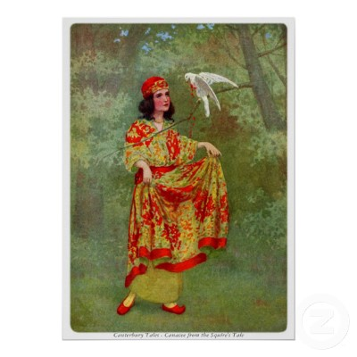
Next day...
Canace was very excited to try that so she woke up early and went outside alone
In the garden while having a walk she heard a Fowl singing, she understood the word of its song perfectly as it sang.
Canace proceeding, heard a female falcon crying and beating herself.

Slide 12
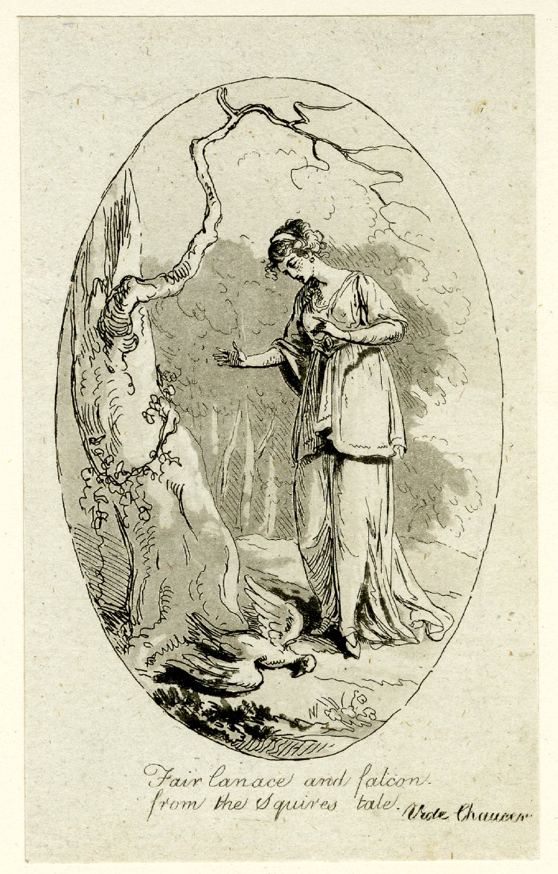
The Falcon...
The female falcon was crying and beating herself
Canace asked why was she crying
The falcon crying, fell off the tree
Canace took her in her laps
The falcon begun to reveal her grieve...

Slide 13
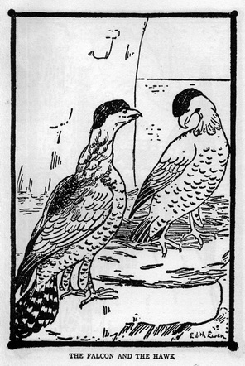
The Falcon’s tale...
“Once upon a time there lived a male handsome falcon in my neighbourhood. Soon we both fell in love with each other. He had made many promises to me and I trusted him. When he found a new female hawk in our neighbourhood he left me and went with her. I feel so dumb to be trusting on such a betrayer.”
“I want to kill myself I don’t want to live anymore.”
Falcon & Hawk

Slide 14
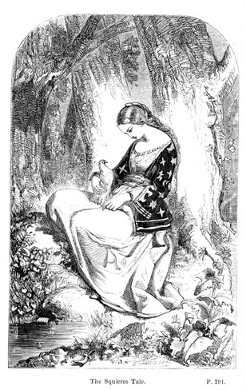
At last...
Canace healed her with the help of the herbs as guided by the ring
Then Canace took the Falcon to her palace and kept her there.

Slide 15
Squire...
The Squire was not able to finish his tale as he was interrupt by Franklin and then annoyed by this behaviour host asked him to tell the next tale.

Slide 16
THE END
Source for all pictures: https://www.google.com

