Slide 1
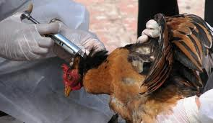
H5N1
AVIAN
INFLUENZA
By: Steven Yonan

Slide 2
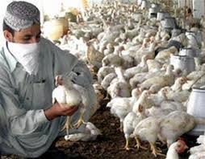
What is that?
Refers to an illness caused by any of many different strains of influenza viruses that have adapted to a specific host.
It considers as a flu.
You do get Fever and lose vision when you have it
It has caused serious outbreaks in domestic poultry in parts of Asia and the Middle East.

Slide 3
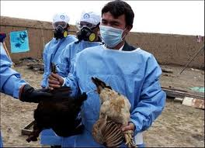
Vector-Borne
Wild birds may act as temporary vectors for HPAI H5N1 as suggested by the water-borne transmission when HPAI H5N1 shedding is peaking in poultry. H5N1, Medicine is a social science, and politics is nothing else but the director of the CDC's Vector-Borne Infectious Disease Division.

Slide 4
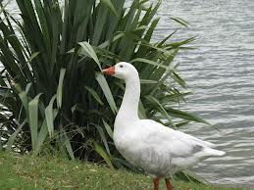
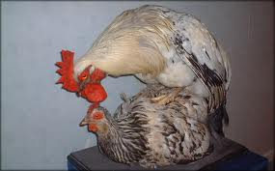
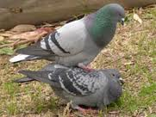
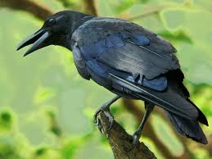
Vectors
It is also possible that poultry can transmit the virus to wildlife when they share the same ecosystem.
Especially ducks, were directly spreading the highly pathogenic strain of H5N1 to chickens, crows, pigeons, and other birds and that it was increasing its ability to infect mammals as well.

Slide 5
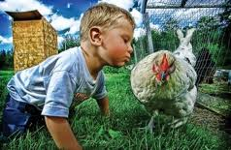
From animals to humans
Almost all cases of H5N1 infection in people have been associated with close contact with infected live or dead birds, or H5N1-contaminated environments. The virus does not infect humans easily, and spread from person to person appears to be unusual. There is no evidence that the disease can be spread to people through properly prepared and thoroughly cooked food.

Slide 6
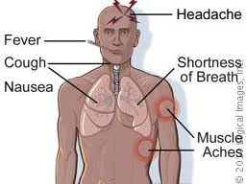
Symptoms
The symptoms of H5N1 infection may include fever and cough, sore throat, and muscle aches. Other early symptoms may include abdominal pain, chest pain and diarrhea. The infection may progress quickly to severe respiratory illness (for example, difficulty breathing or shortness of breath, pneumonia, Acute Respiratory Distress Syndrome)
Ending stage is death.

Slide 7
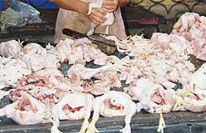
Health Issues
the number of `blind spots’ we have around the world, we are dealing with huge gaps in our knowledge of what is actually going on.
No black teeth, or worms in blood.
You may get sick again, and it is just as bad as it is .

Slide 8
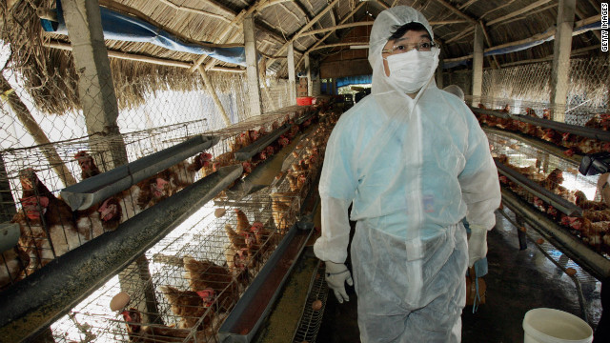
Affective
The majority of cases have occurred among children and adults aged less than 40 years old.

Slide 9
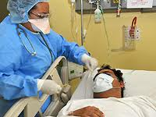
Human-to-Human
Suggest that statistical methods can prove or confirm human-to-human transmission, but this suggestion is misleading. Modeling approaches can suggest transmission modalities to account for case patterns, but determination of human-to-human transmission requires detailed field epidemiologic investigations in which human, animal, and environmental exposures as well as clinical and laboratory data are assessed and interpreted.
It needs a vector to be transmitted.

Slide 10
Medications & Developing
There's no cure for any kind of flu. The H5N1 bird flu bug has been particularly deadly for people unlucky enough to catch it
H5N1 may cause more than one influenza pandemic, as it is expected to continue mutating in birds regardless of whether humans develop herd immunity to a future pandemic strain.

Slide 11
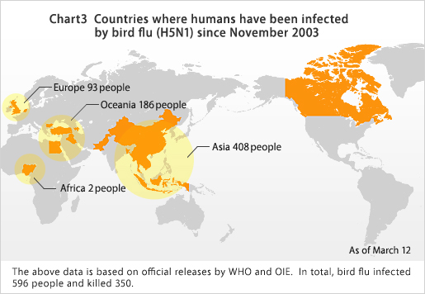
H5N1 spread in the world

Slide 12
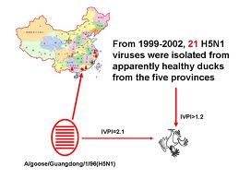
Discovering
They still have H5N1 now days.
It was first discovered in Asia
Bird flu virus H5N1 is isolated for the first time from a human patient in Hong Kong.

Slide 13
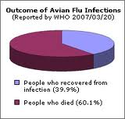
Death by H5N1
In January of this year a major outbreak occurred among poultry in Vietnam: 33 of the 64 cities and provinces were affected. In an attempt to contain the epidemic, 1.2 million poultry were slaughtered. It is estimated that over 100 million birds died of the disease.
More people may have died from the Black Death of the 13th century

Slide 14
Hope you like it

