Slide 1
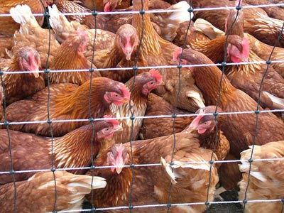
Bird Flu
Mirna kambar

Slide 2
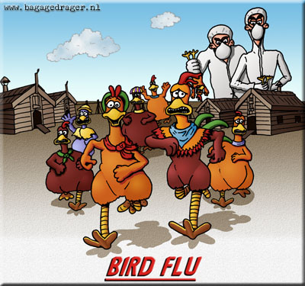
where they came from ?
They came from Hong Kong in 1997

Slide 3
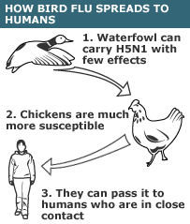

Slide 4
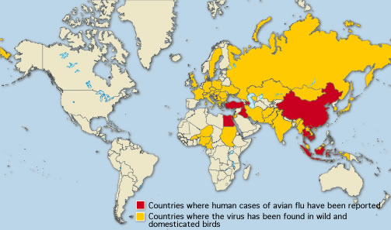
how the bird flu spread to other countries?
the bird flu virus has spread to birds in countries in Asia, Africa and Europe.

Slide 5
How did it happen?
Birds, just like people, get the flu. Bird flu viruses infect birds, including chickens, other poultry and wild birds such as ducks. Most bird flu viruses can only infect other birds. However, bird flu can pose health risks to people.

Slide 6
outbreak of bird flu
people who have contact with infected birds can become sick. It may also be possible to catch bird flu by eating poultry that is not well cooked or through contact with a person who has it. Bird flu can make people very sick or even cause death. There is currently no vaccine.

Slide 7
Birds
just like people, get the flu. Bird flu viruses infect birds, including chickens, other poultry and wild birds such as ducks. Most bird flu viruses can only infect other birds.
However, bird flu can pose health risks to people. The first case of a bird flu virus infecting a person directly, H5N1.

Slide 8
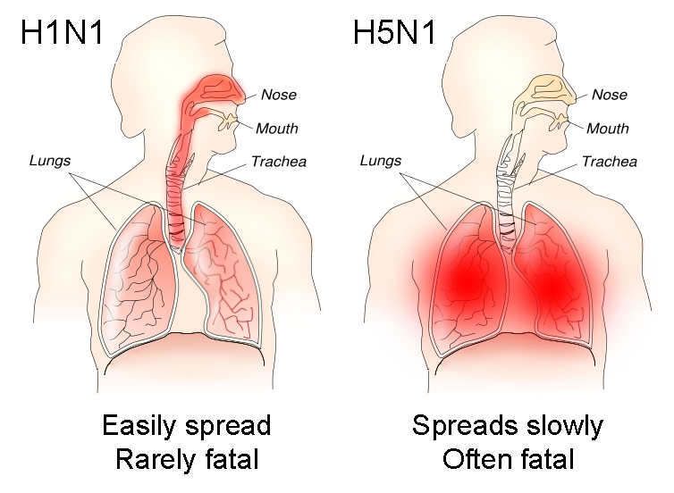

Slide 9
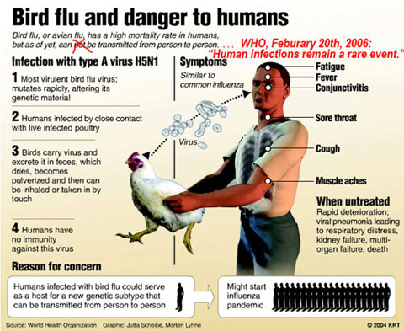

Slide 10
